Slide 1
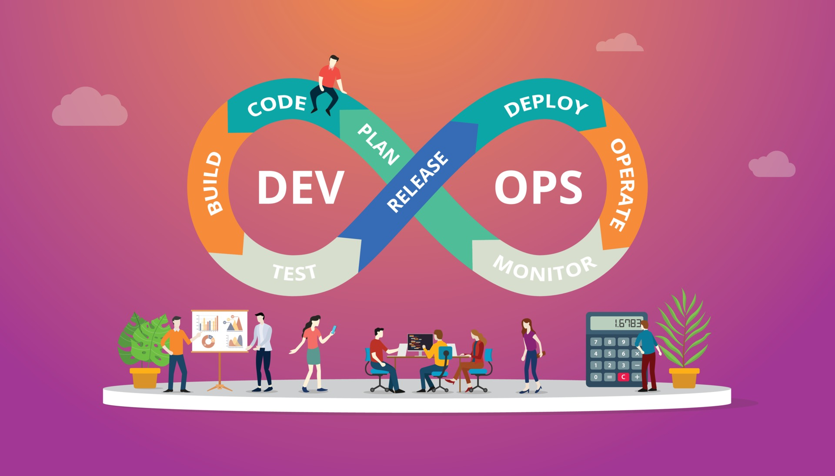
Adam Clarke
Narcis Girones Sancho
CodeSpace - Software Development

Slide 2
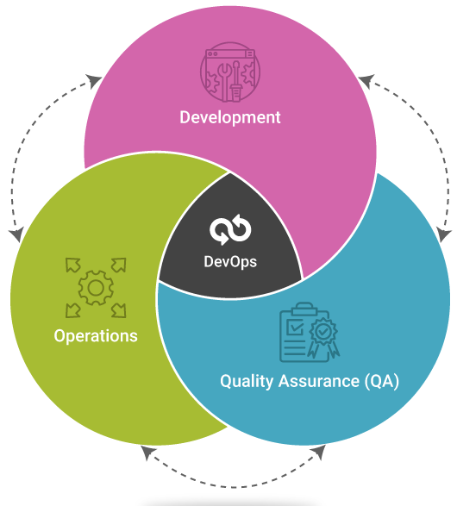




What is DevOps?
DevOps is a software development practice that aims to unify software development (Dev) and software operations (Ops)
The goal is to improve the flow from development to operations by working together and understanding each other’s challenges
Based in 4 pillars:
Communication
Collaboration
Automation
Monitoring
Key principles:
Continuous Integration (CI)
Continuous Deployment (CD)
Infrastructure as Code (IaC)
Monitoring and Feedback Loops
Enables the creation of software quickly and with high quality

Slide 3
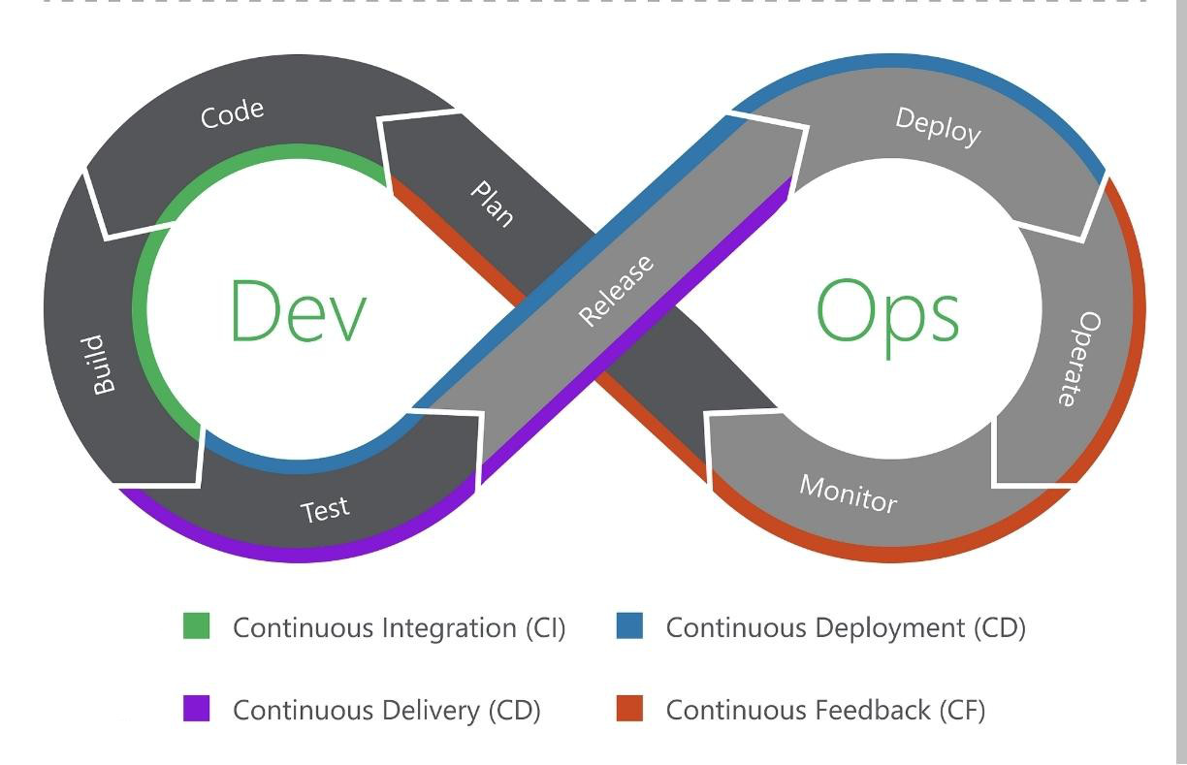
DevOps - Iterative lifecycle
Closely related to agile methodologies, such as Scrum or Kanban

Slide 4

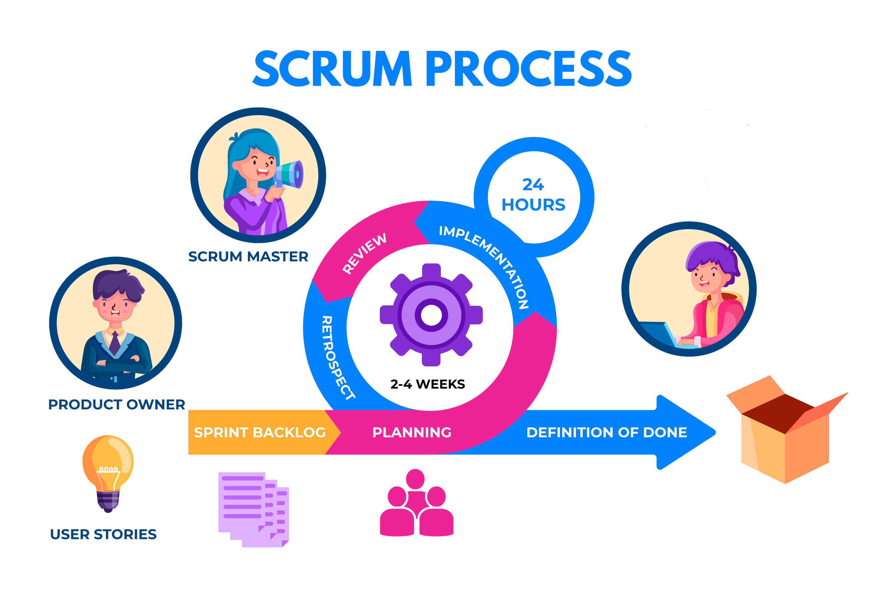




DevOps - Planification
When teams define, describe, and ideate the features and capabilities of the systems and applications they are building
Where sprints are planned, and individual issues are assigned to various members of the team
Where teams manage changes, bugs or new features
Project managers and product owners review the feedback gathered from the previous development cycle and use it to determine what backlog items provide the most value to end users

Slide 5
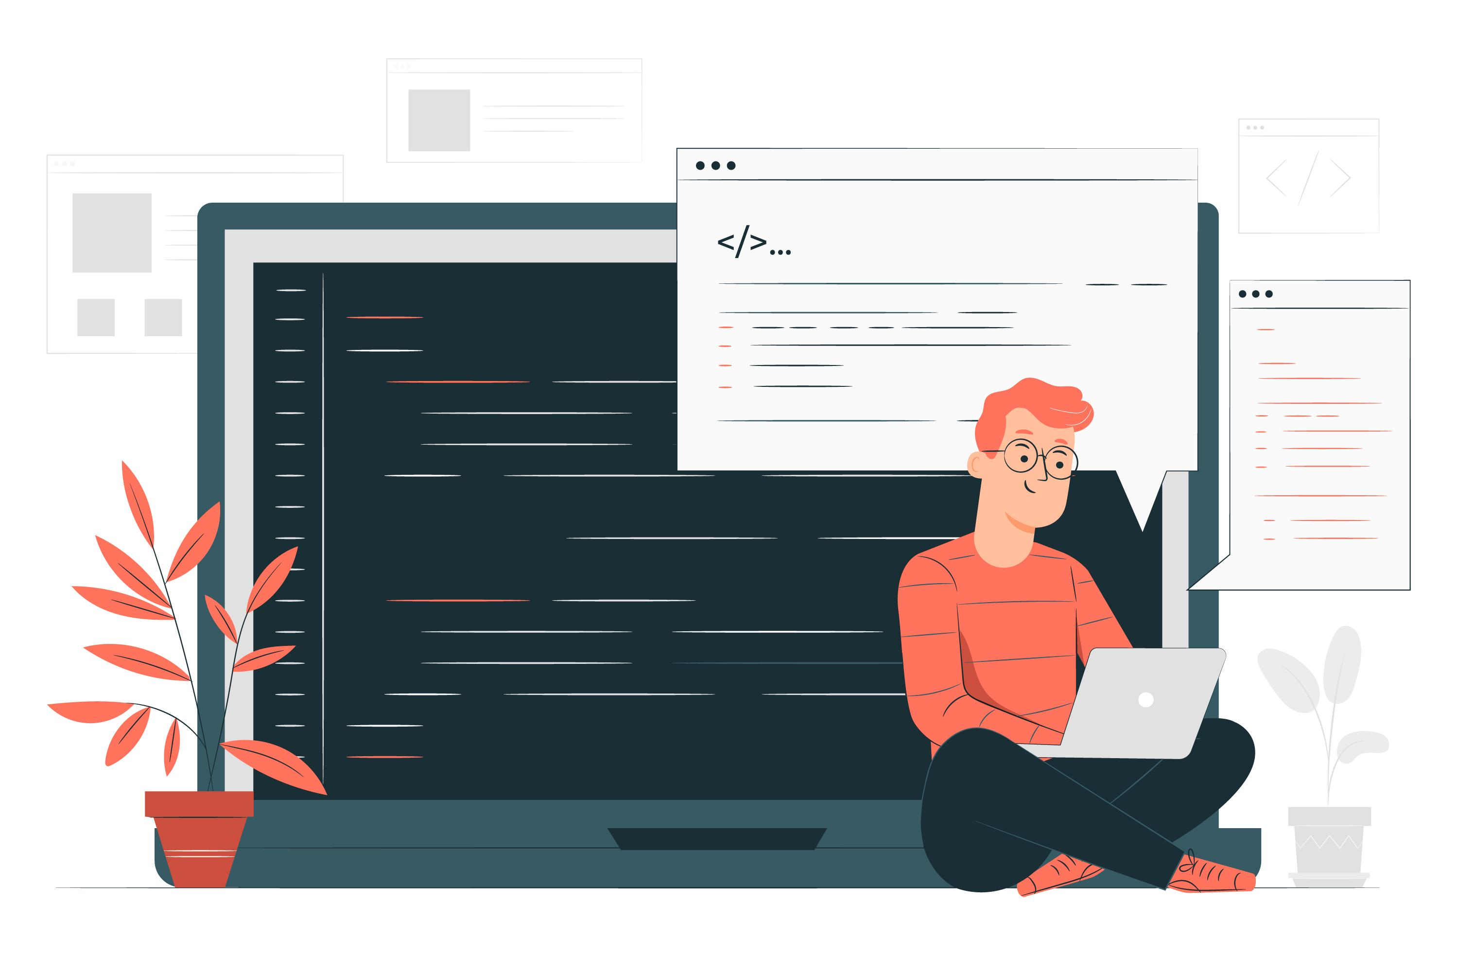



DevOps - Code: Quality software
Where developers write Quality software.
Collaboration is key; teams work together using version control.
Developers follow coding standards for quality and maintainability.
Have a unique repository for version control systems.
Ensures that the necessary development tools are provided to all the team members.

Slide 6

DevOps - Build: Compiling Code into Artifacts
Where Artifacts (functional product) are generated based on the new code.
Continuous Integration – release process.
Automation component
Integrate frequently
Goals of CI:
Find and address bugs quicker
Improve software quality
Reduce time for validation
Release new software updates

Slide 7
DevOps - Test: Ensuring Quality and Stability
Ensure code quality and stability system.
Different types of tests:
Unit
Performance
Integration
Functional
Non-Functional
Stability
Smoked
Usability
End-to-End
Automated testing speeds up the feedback loop.
Think of it as a stress test to see if everything I working correctly.

Slide 8

DevOps - Release: Preparing for Launch
The release phase involves coordinating the final steps needed to deliver software, including:
Testing
Documentation
User approvals
It ensures that the product is not just working, but ready for real-world use by customers.
This phase is crucial for minimizing risks before deployment.

Slide 9
DevOps - Deploy: Delivering the Software
The deploy phase focuses on executing the plan created in the release phase.
This phase may involve
Depending on the organization’s needs.
It includes automated processes like CI/CD pipelines to handle deployment quickly and accurately.
Rolling Updates
Canary Releases
Full Deployment
Deployment ensures that the product is available in the production environment, where it is visible and accessible to end-users.

Slide 10

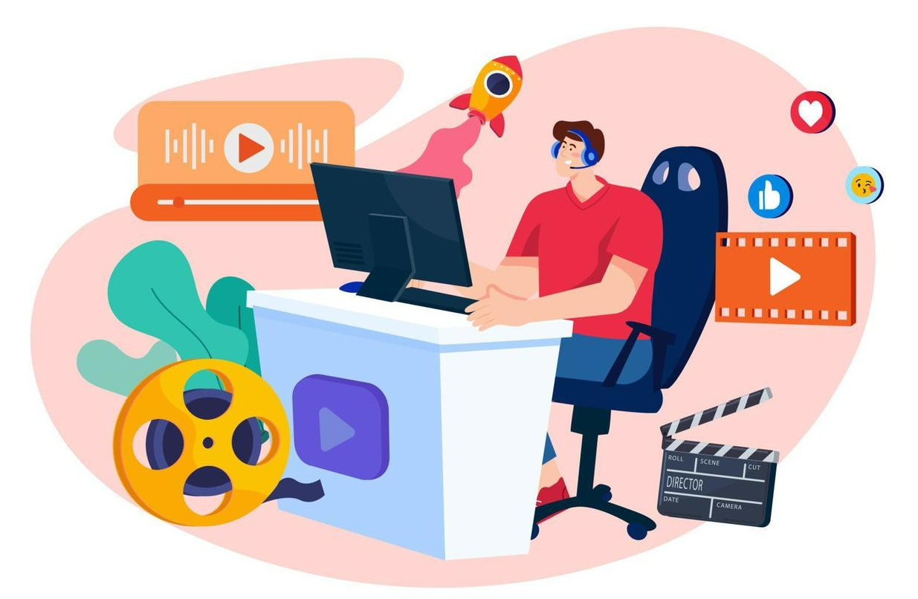

DevOps - Operate: Keeping the System Running
During the operate phase, monitoring tools are used to track the health of the software, ensuring it is running smoothly.
Teams address any performance bottlenecks or bugs that occur, often using real-time alerts to stay on top of problems.
Regular maintenance ensures the system stays stable and secure over time.
Continuous feedback loops help the team plan for future updates or fixes.

Slide 11



DevOps - Monitoring
Involves overseeing the entire development process, from planning, development, integration and testing, to deployment and operations
Provides a comprehensive, real-time view of the status of applications, services, and infrastructure in the production environment
Why monitoring?
Improve stability and reliability:
Detect errors faster
Reduce the impact in case of failure
Minimize downtime
Resolve errors more quickly
Improve reliability and stability
Continuous product improvement:
Better understand our users
Use user navigation data to improve our product
Detect user reactions after a change

Slide 12


